Slide 1





Growth Strategy Through HealthTech: Israel as a Global Powerhouse in Medical Devices
Hadas Klein
Life Science & Health Cluster
The National Program for Economic Growth
Notes:
I’m honored to be here today & Im very excited to meet you all
I believe
that
together,
we have the power to transForm healthcare worldwide
My name is Hadas Klein, and I am the manager of the Health Cluster. I am a psychologist and im passionate about promote innovation in healthcare organizations.
today I will share with you how the Health Cluster is shaping Israel’s economic future.

Slide 2
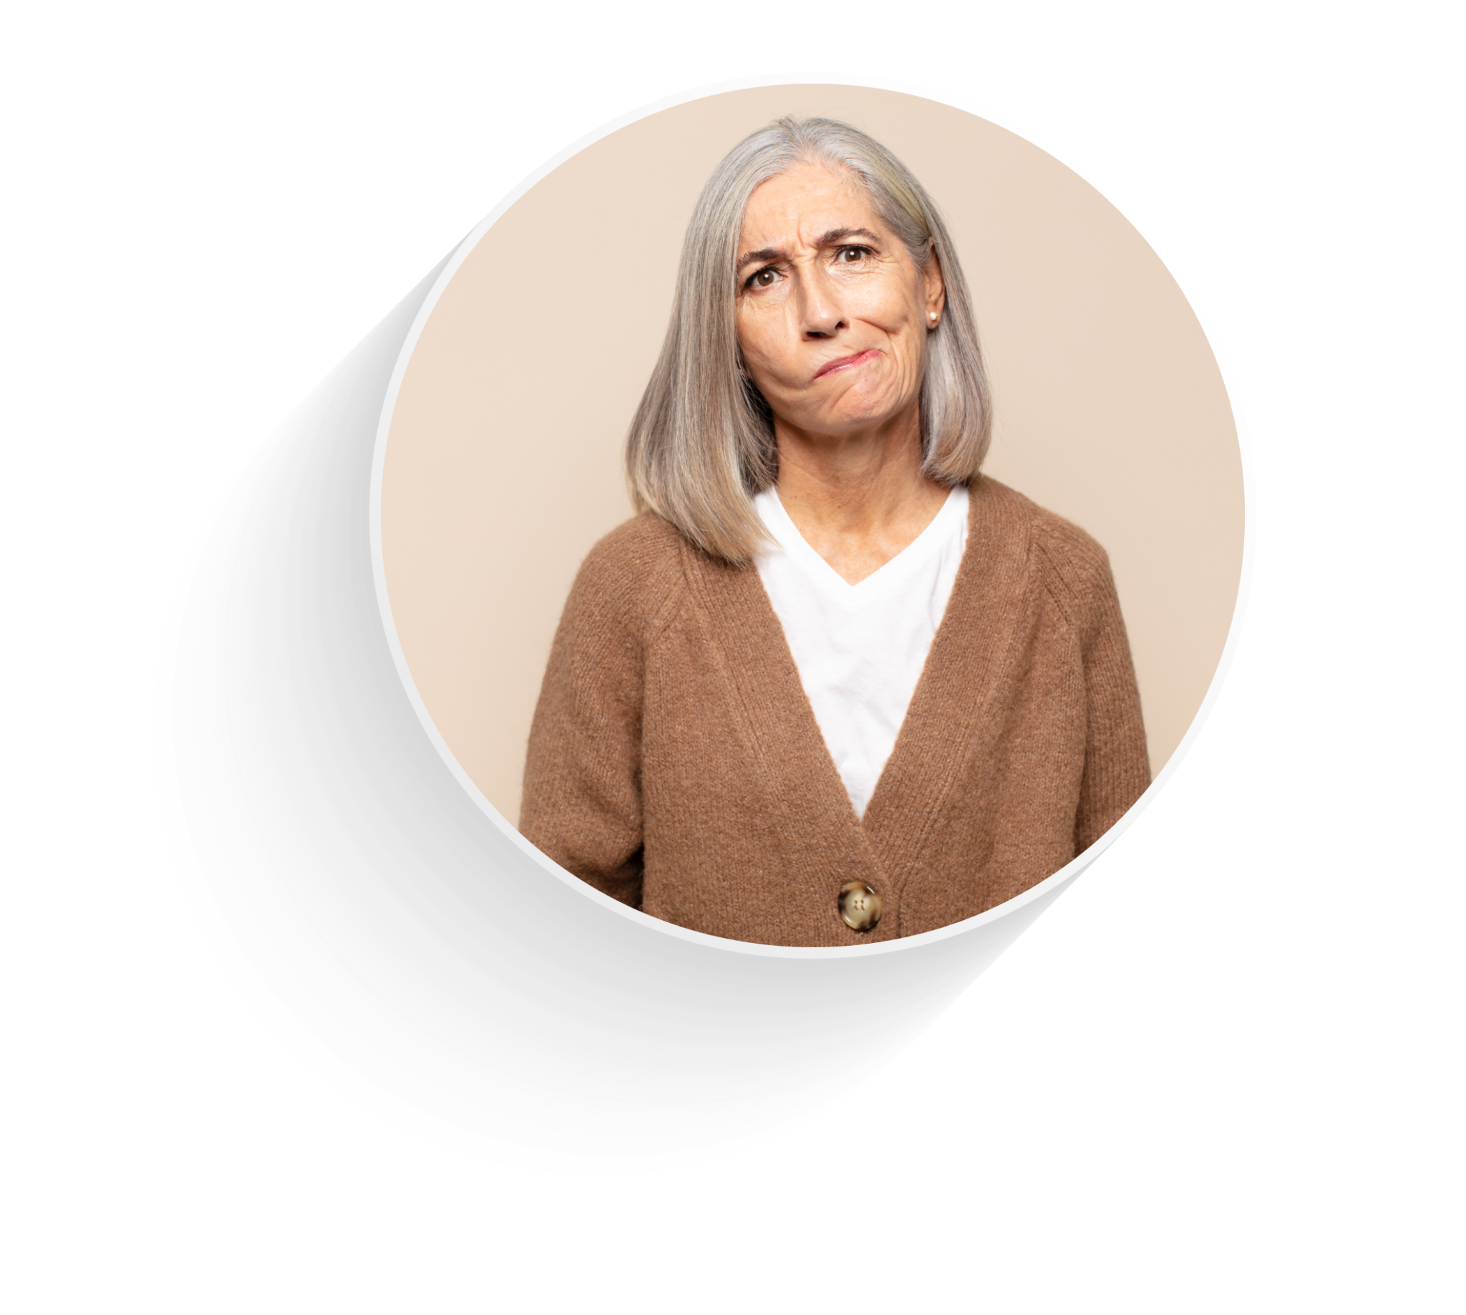



HEALTHCARE SYSTEMS WORLDWIDE ARE FACING
Global Challenges
Aging Population
Chronic Disease Management
Maternal and Child Healthcare
Access to Health
Services
Notes:
Healthcare systems worldwide are facing global challengES, including
Health servicES
Specially in remote areaES.

Slide 3
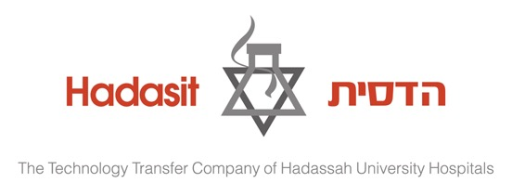



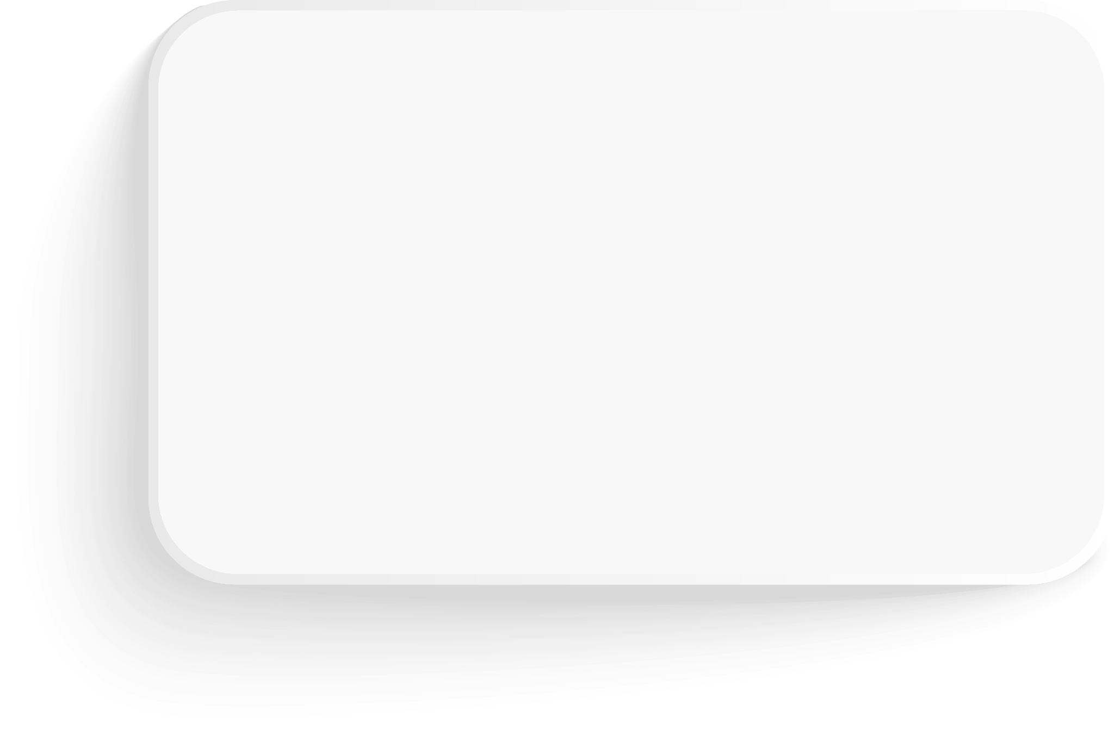
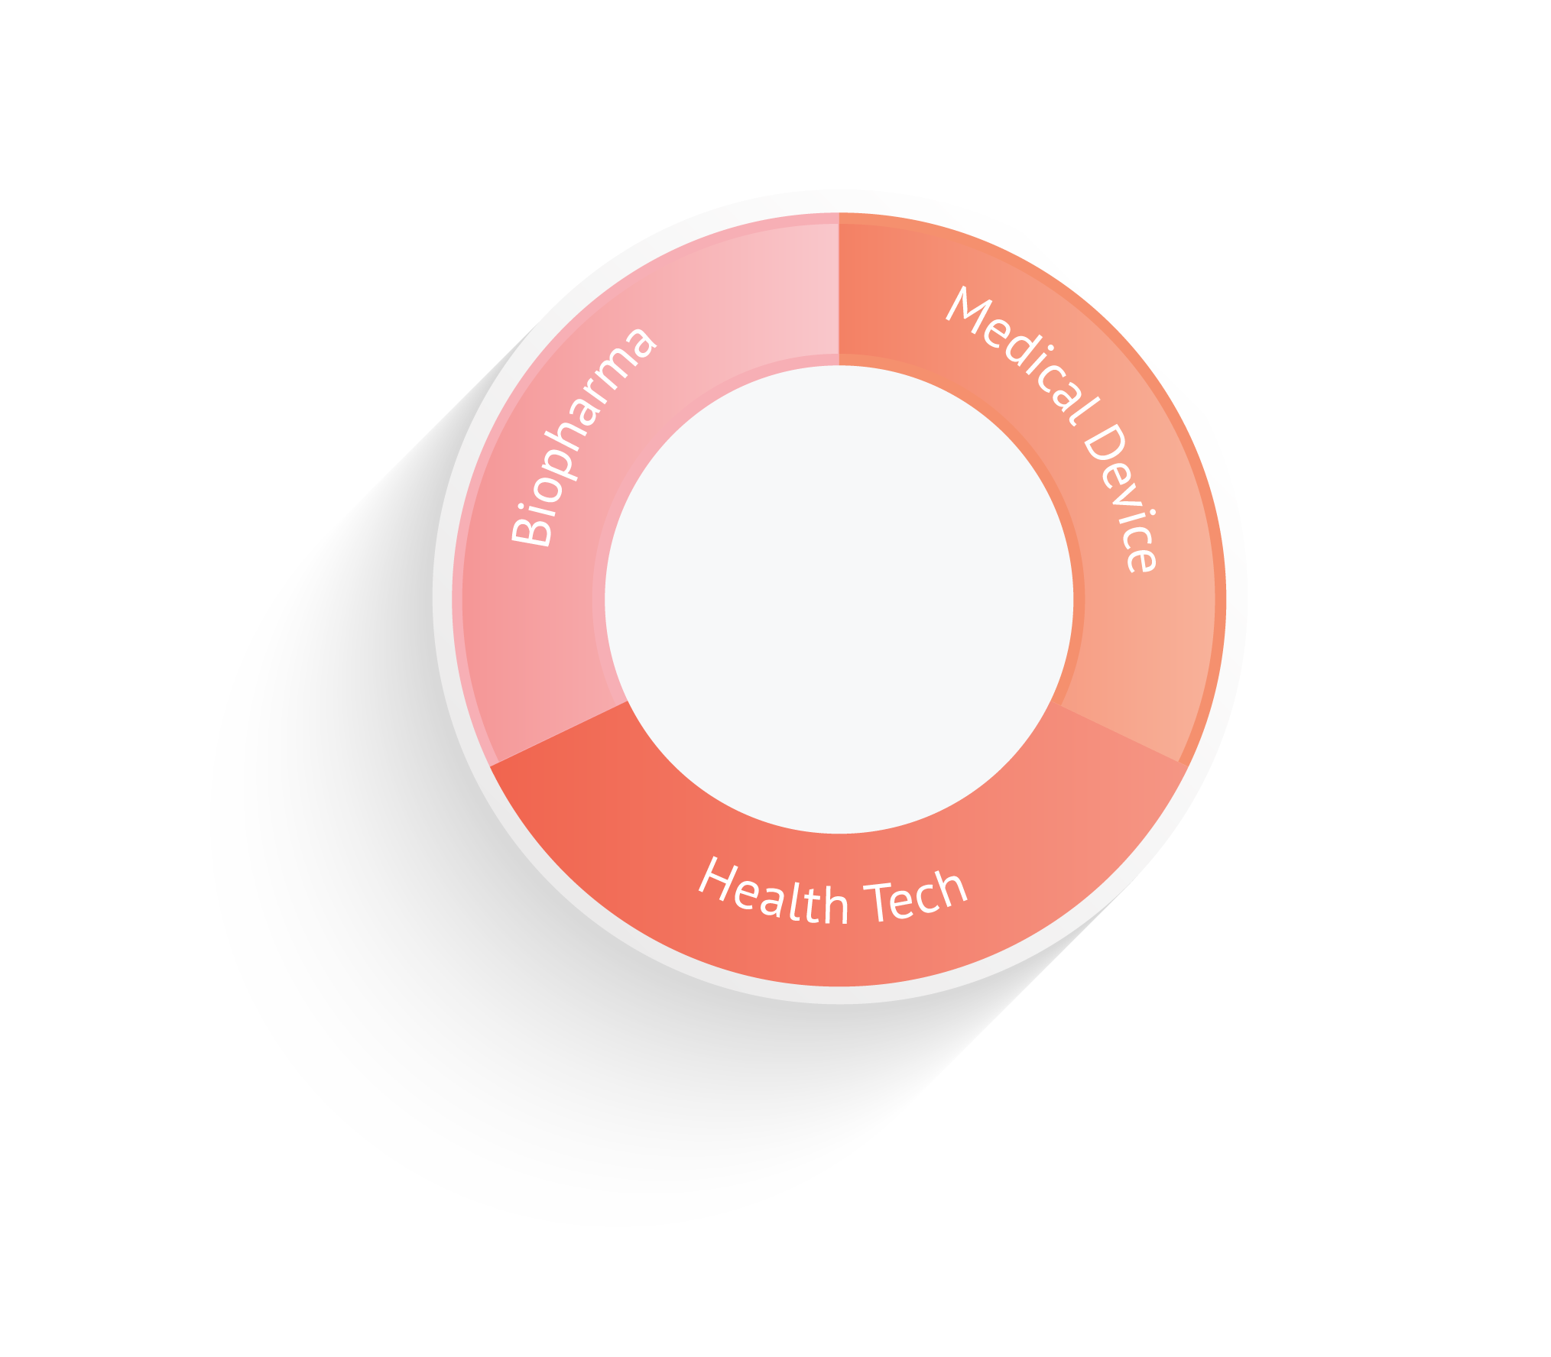




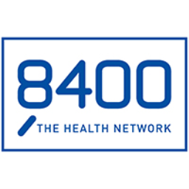

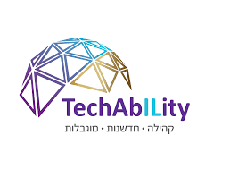




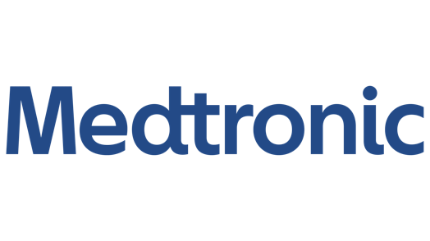



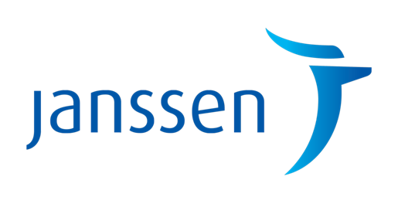






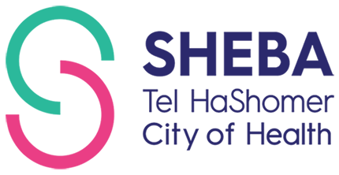

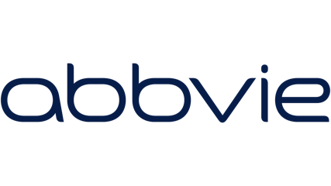








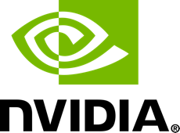



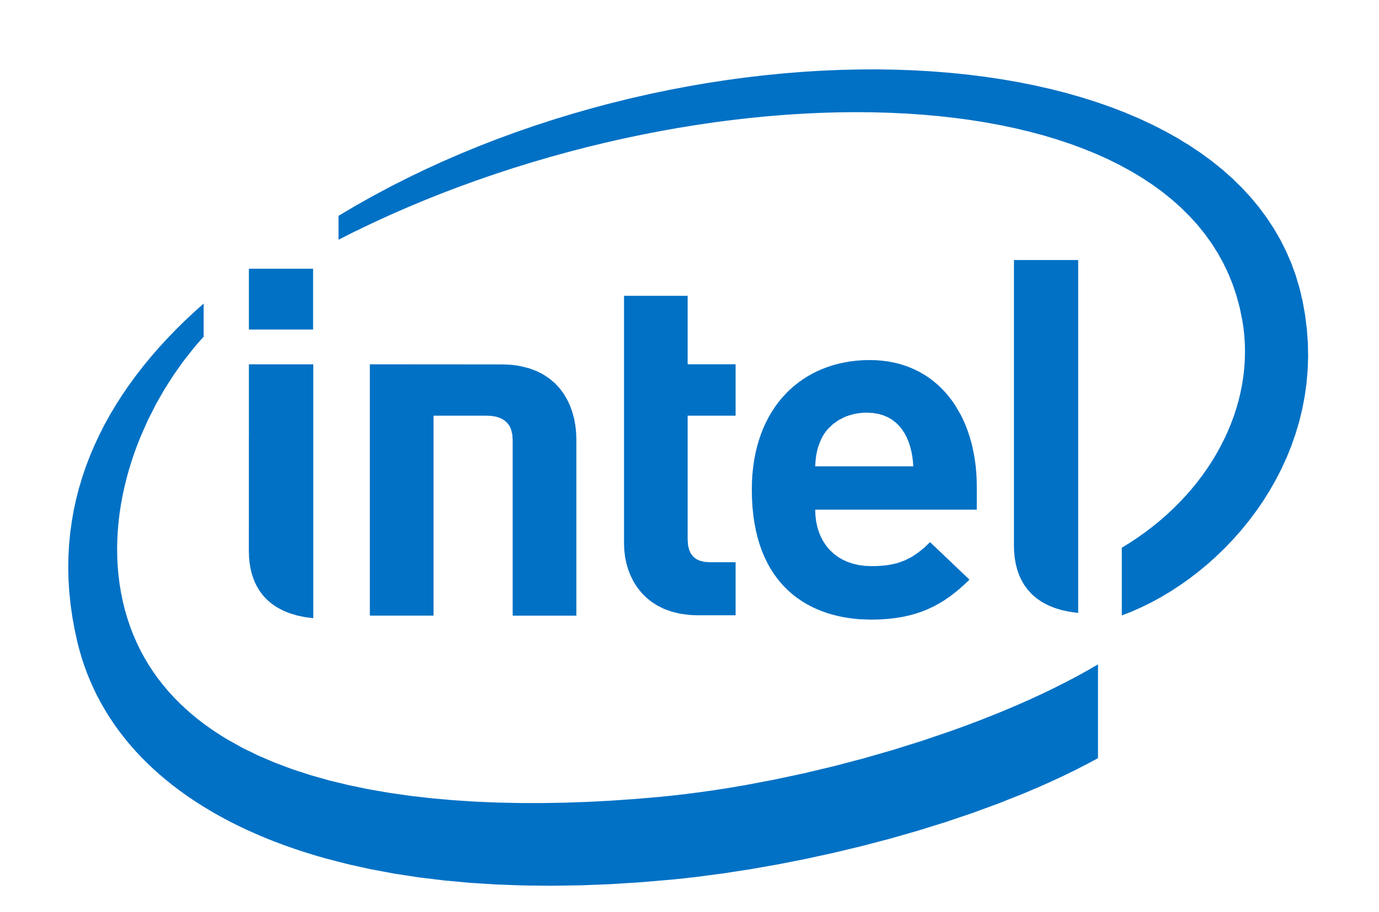






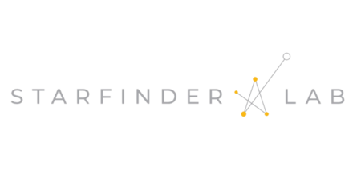



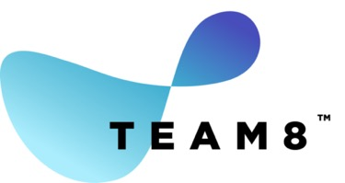

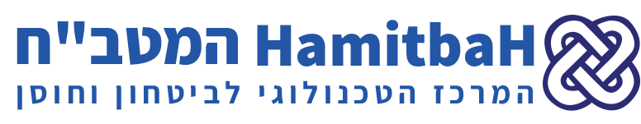
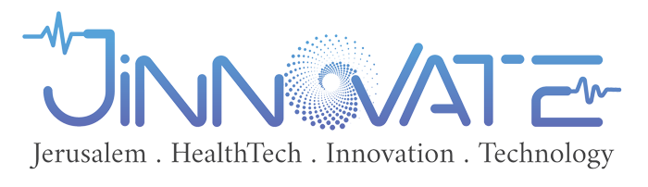

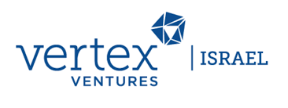


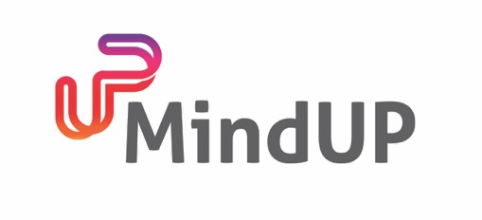
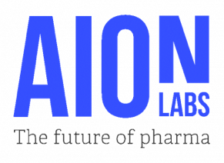
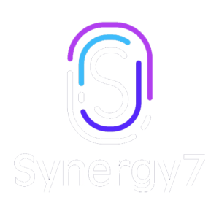
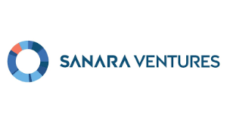







UNITING FORCES TO TACKLE
Global Challenges
Academia TTOs
Government
& IFCs
2000+
Health Tech
Companies
65 Health
Organizations
75 MNCs
Investors
HUBS
&
Incubators
Notes:
Israel has built a broad ecosystem over the past decade that makes it easier to develop solutions for these challenges.
Not just startupS
Ecosystem
Combination
fast

Slide 4
Companies by Segment -
Fluctuating figures
Notes:
So how can we collaborate?
Where do we start?
Here are few Example:
by leveraging India’s unique manufacturing power We can reduce costs, shorten timelines and accelerate drug validation
With India’s advanced healthcare system and growing demands, we can partner with Indian distributors ensure effective access to diverse markets in Medical devices and HealthTech.

Slide 5
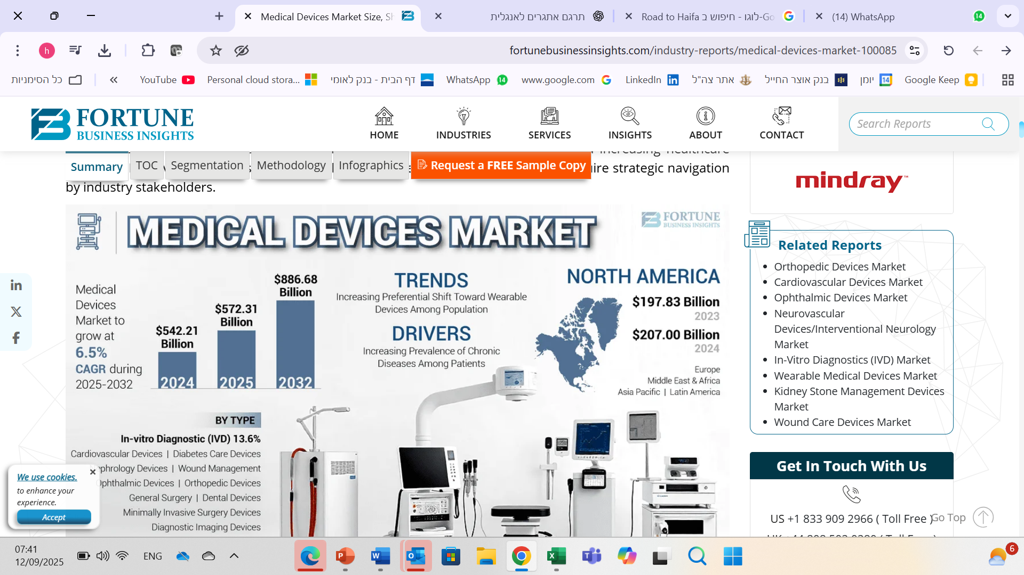
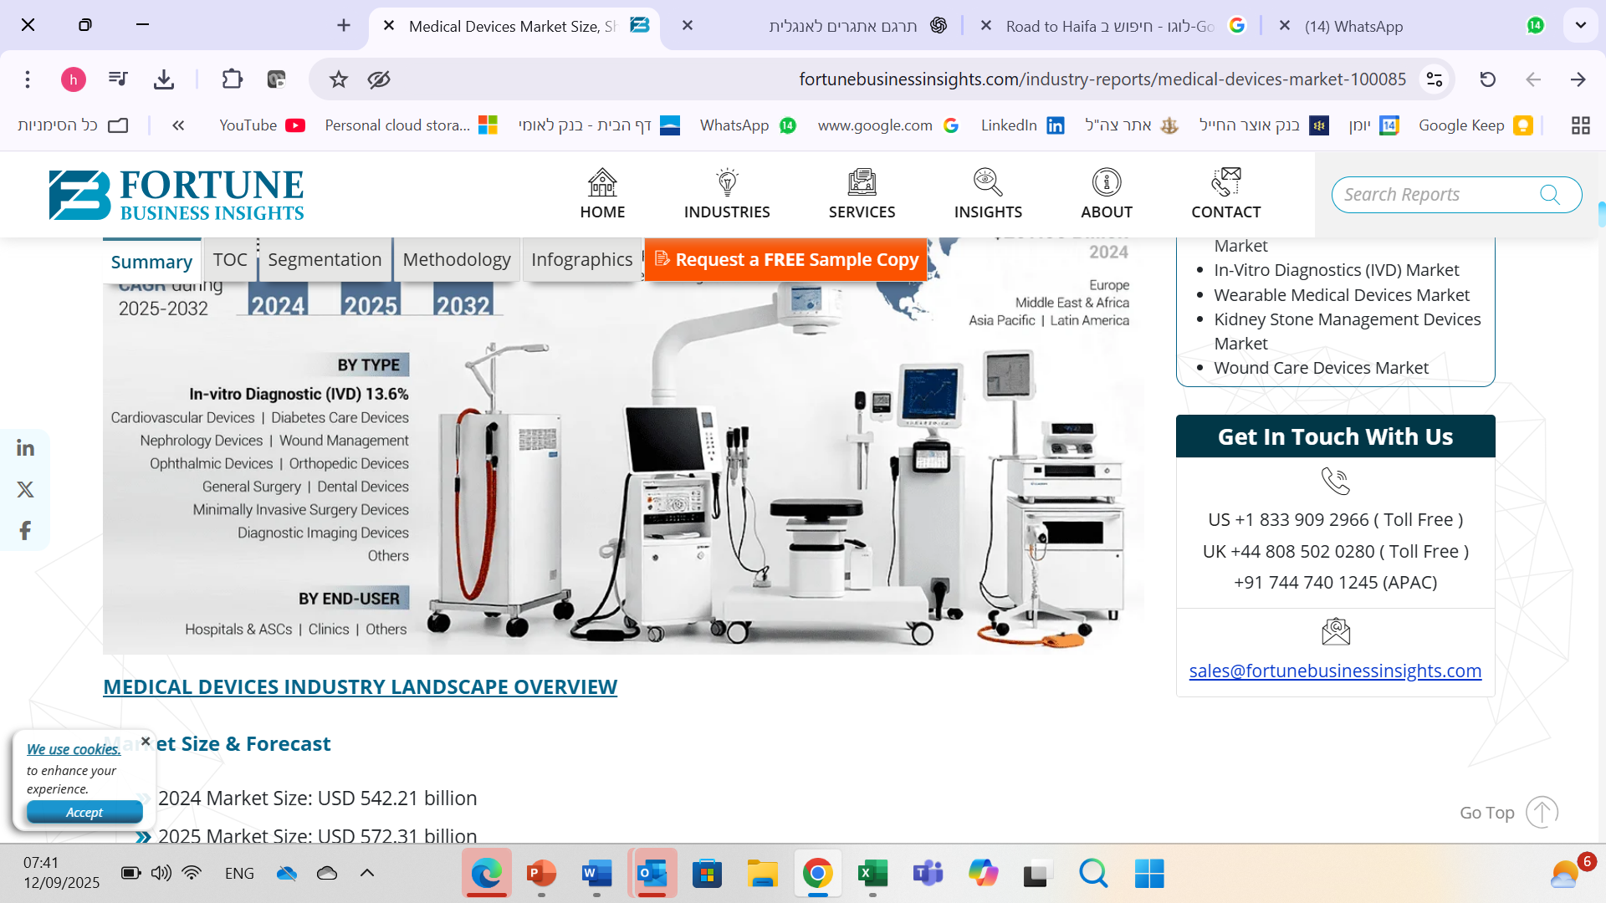
Notes:
So how can we collaborate?
Where do we start?
Here are few Example:
by leveraging India’s unique manufacturing power We can reduce costs, shorten timelines and accelerate drug validation
With India’s advanced healthcare system and growing demands, we can partner with Indian distributors ensure effective access to diverse markets in Medical devices and HealthTech.

Slide 6
Medical device Companies by Year
Consistent growth in the number of startups in the sector
Notes:
So how can we collaborate?
Where do we start?
Here are few Example:
by leveraging India’s unique manufacturing power We can reduce costs, shorten timelines and accelerate drug validation
With India’s advanced healthcare system and growing demands, we can partner with Indian distributors ensure effective access to diverse markets in Medical devices and HealthTech.

Slide 7
Medical device Companies by Medical focus
Notes:
So how can we collaborate?
Where do we start?
Here are few Example:
by leveraging India’s unique manufacturing power We can reduce costs, shorten timelines and accelerate drug validation
With India’s advanced healthcare system and growing demands, we can partner with Indian distributors ensure effective access to diverse markets in Medical devices and HealthTech.

Slide 8
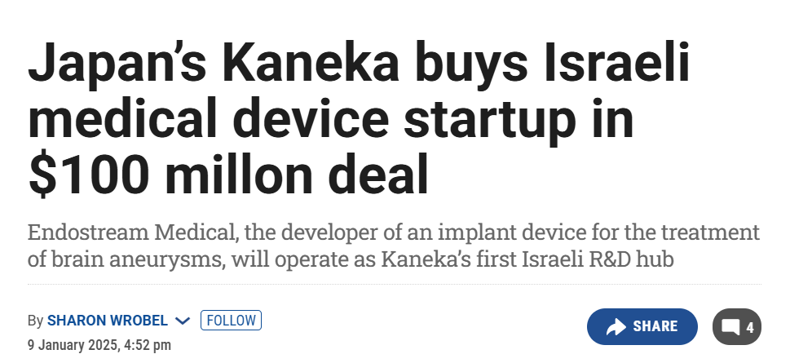
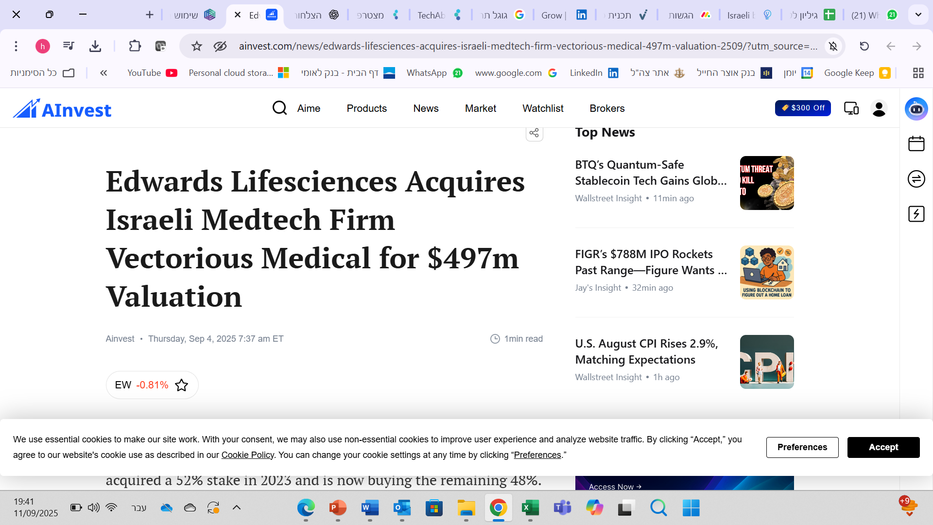
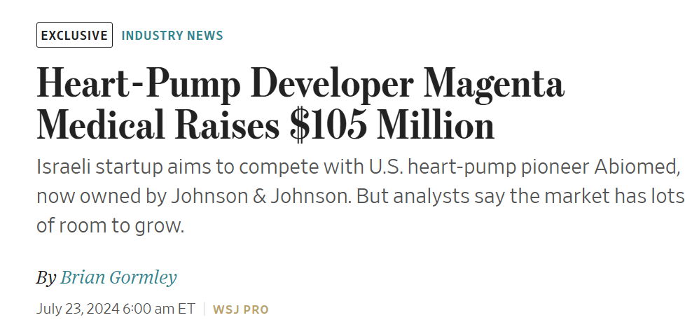
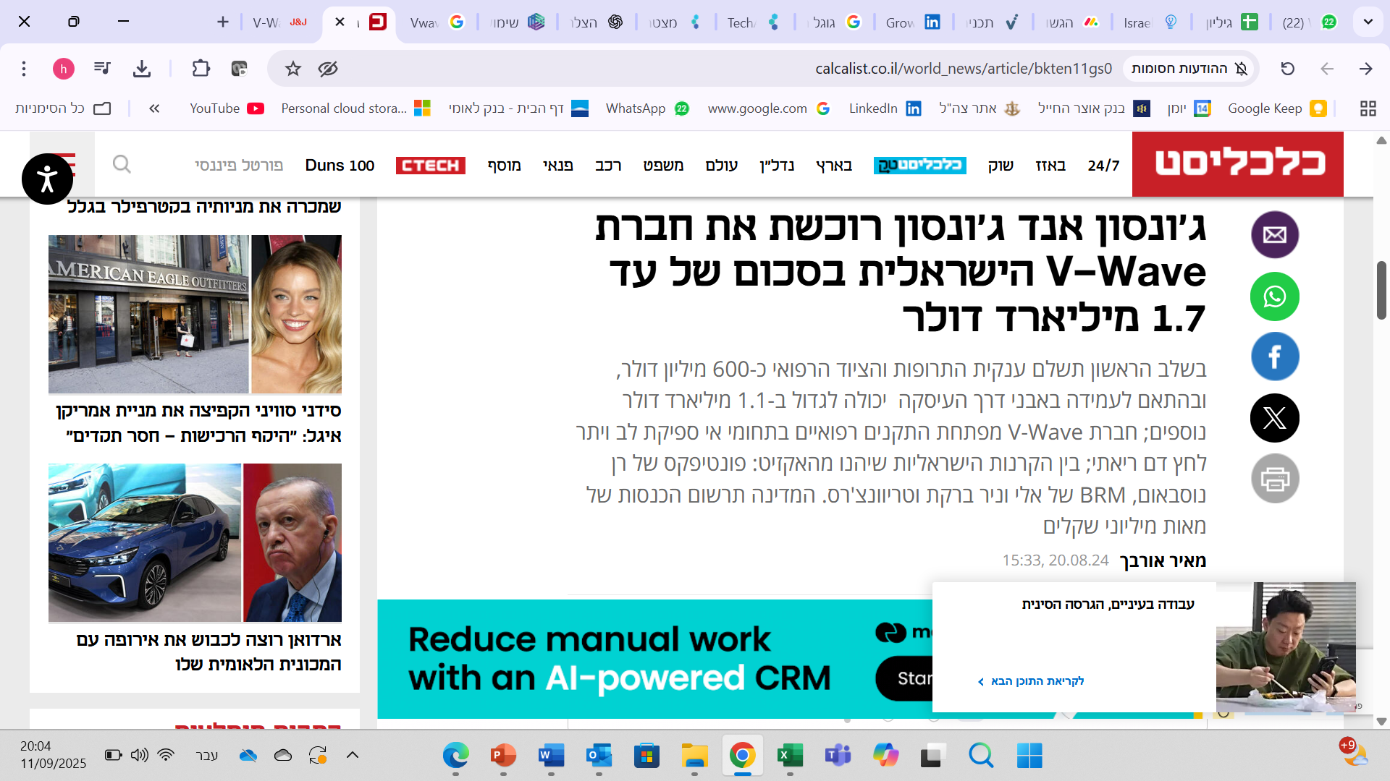
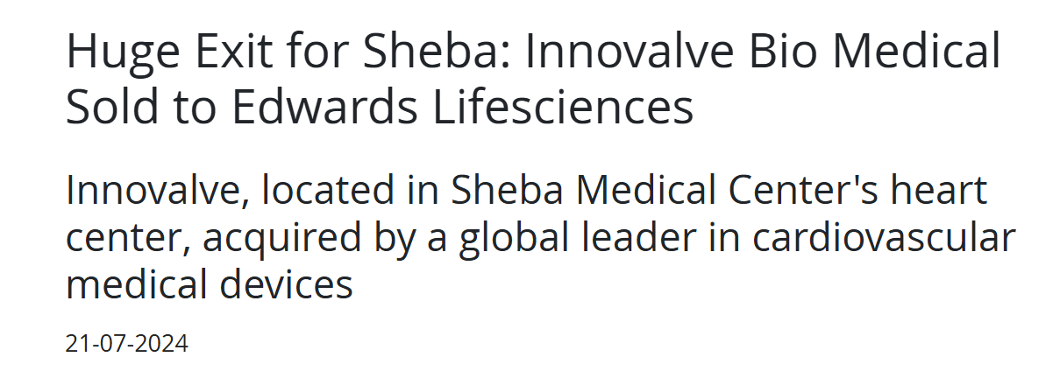
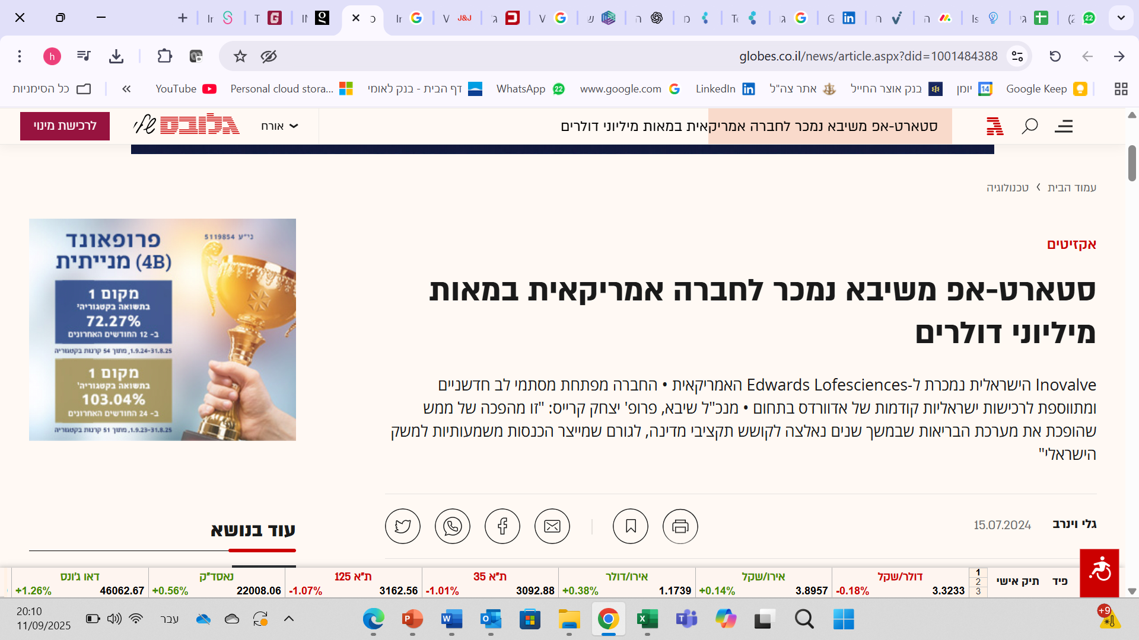
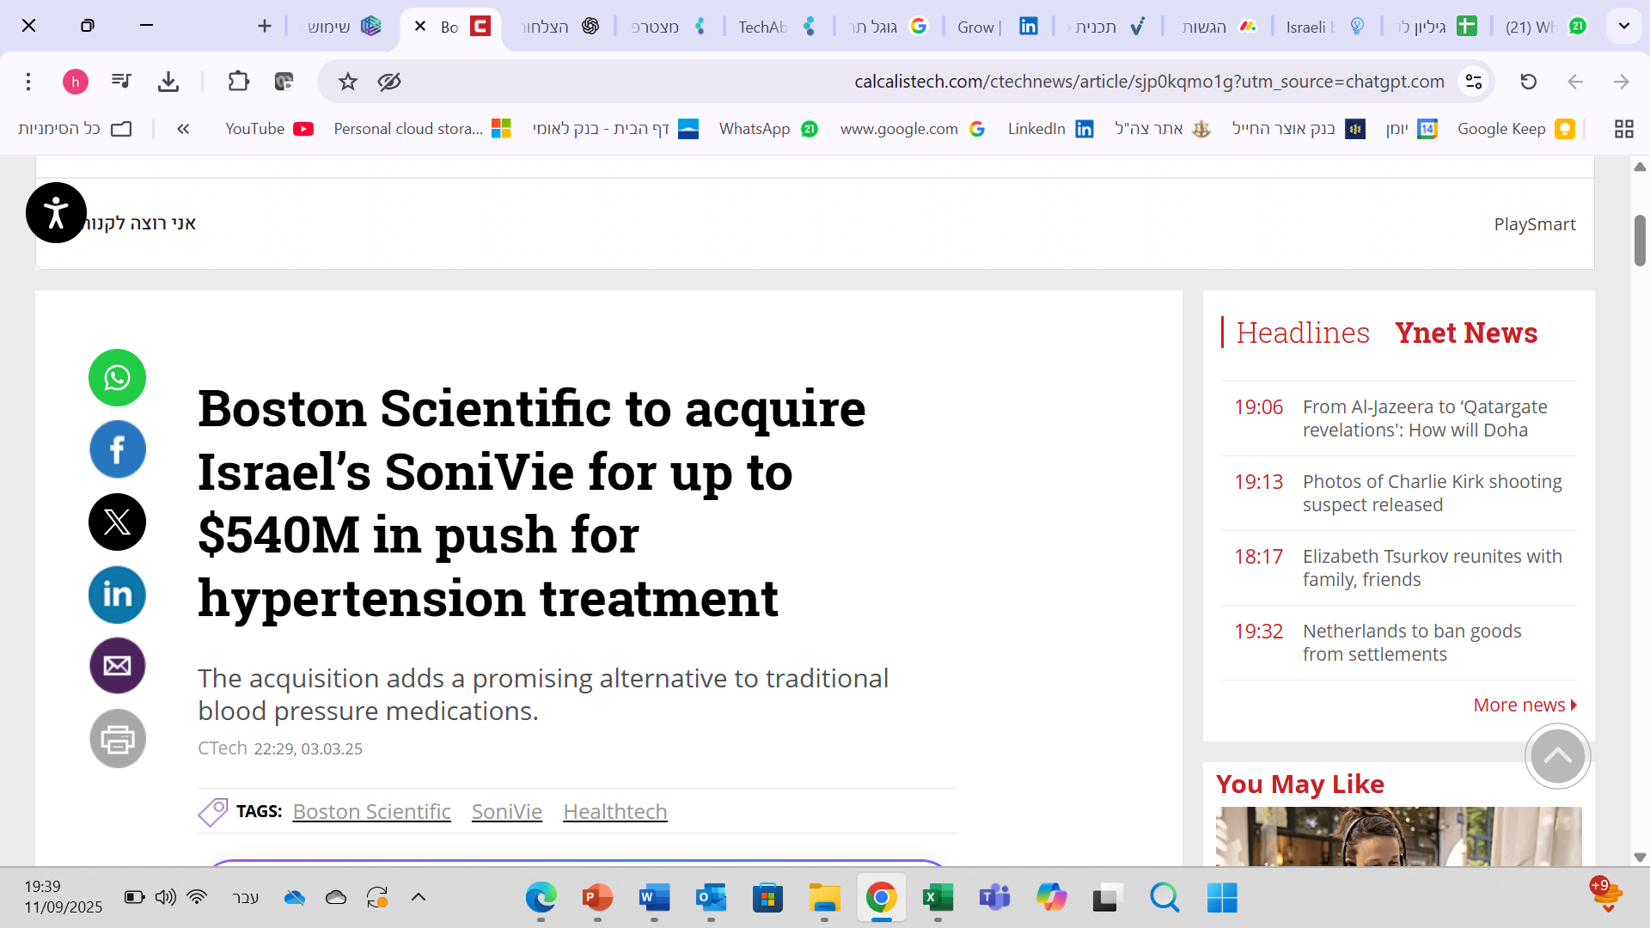
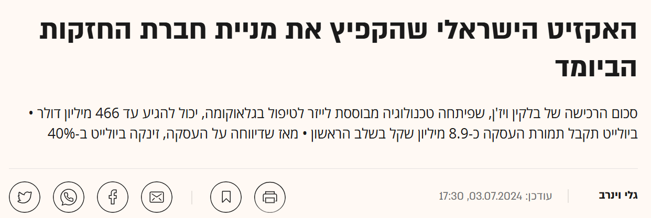

Success Stories
Notes:
And one last example—developed during the war—demonstrating how a global corporation was able to quickly collaborate with an Israeli healthcare organization In order to address a national challenge
Microsoft and Sheba Hospital developed a mental health diagnostic system – LIV
Mental health is unique due to its heavy reliance on free-form language, and in this case—the Hebrew language.
The system conducts a personalized conversation - empathic conversation, simulating a psychiatric intake.
It adapts dynamically based on responses and shares key insights with the healthcare team.
This helps assess urgency, severity, and needs more efficiently. As a result, it reduces wait times, improves large-scale evaluations, and enhances diagnostic accuracy.

Slide 9
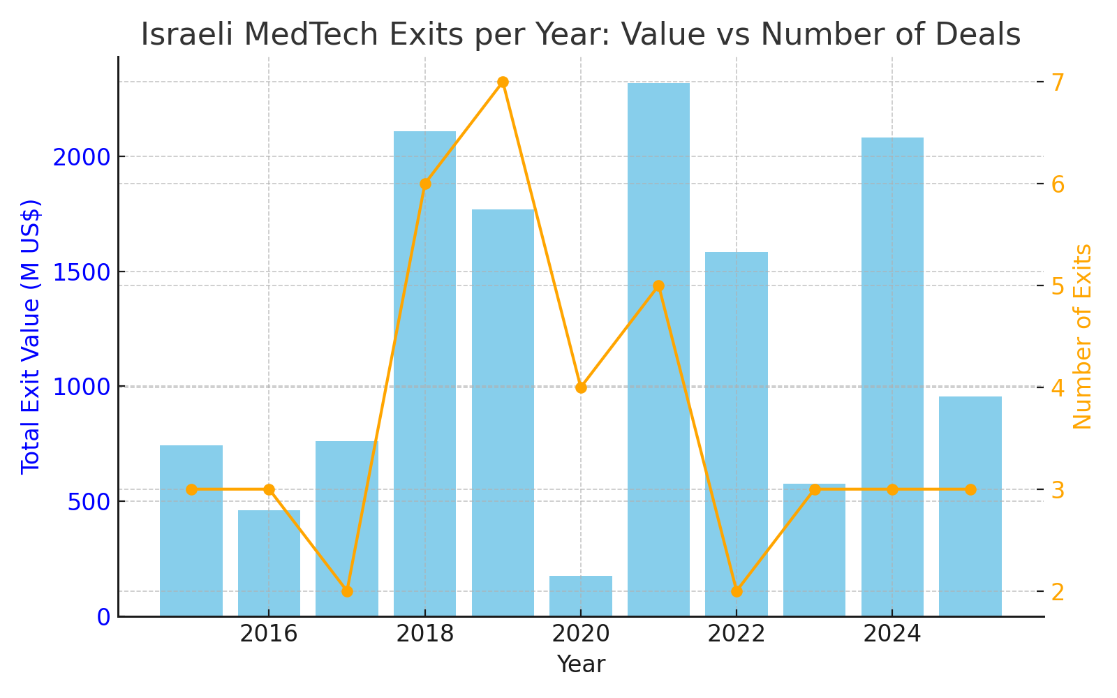
Success Stories
Notes:
And one last example—developed during the war—demonstrating how a global corporation was able to quickly collaborate with an Israeli healthcare organization In order to address a national challenge
Microsoft and Sheba Hospital developed a mental health diagnostic system – LIV
Mental health is unique due to its heavy reliance on free-form language, and in this case—the Hebrew language.
The system conducts a personalized conversation - empathic conversation, simulating a psychiatric intake.
It adapts dynamically based on responses and shares key insights with the healthcare team.
This helps assess urgency, severity, and needs more efficiently. As a result, it reduces wait times, improves large-scale evaluations, and enhances diagnostic accuracy.

Slide 10

Challenges
Difficulty raising funds
The future of the incubators is uncertain
Maintaining and strengthening international corporations in the field
Implementation tools for the Israeli health system
First paying customer

Slide 11
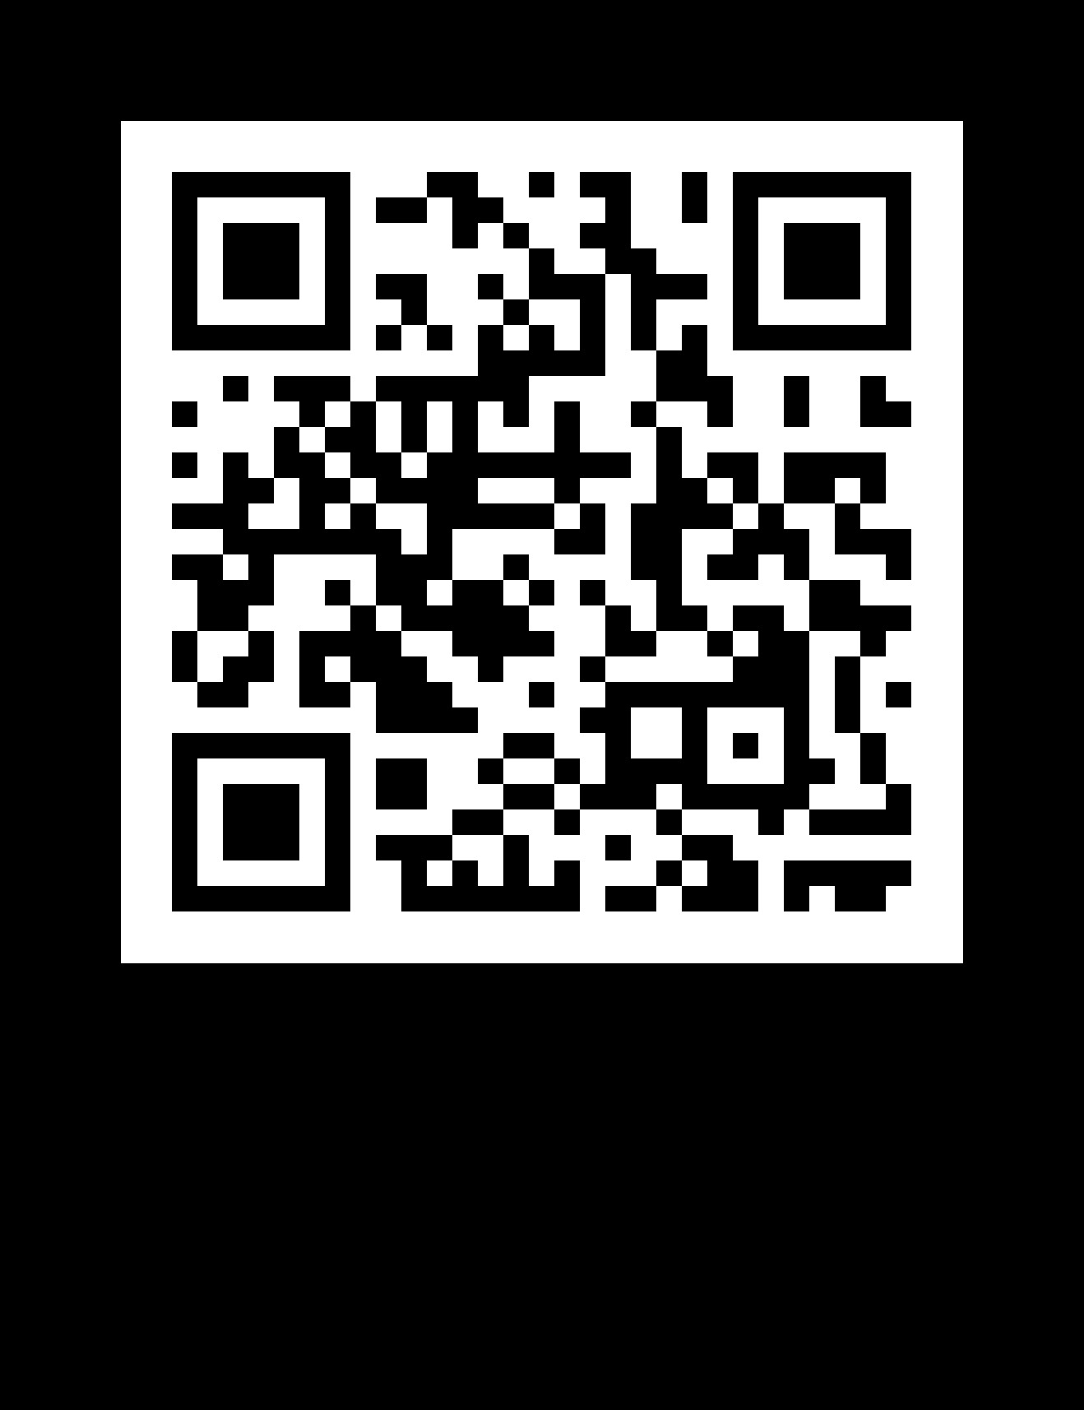


How can we help?
Ecosystem Development
Identifying regulatory and bureaucratic barriers
Enhancing the scope, quality, and effectiveness of stakeholder relations
- through the mishur hachof Cluster
Expanding Funding Sources
through:
- Grants - FUND GURU
Foreign Trade - Mapping and Attracting Investors
Export Support
The Economic Attachés Network
Support in funding and operating conferences, Trade Missions, and Investor Events
Funding Global pilot
Innovation Bridges
Distributor Sourcing Guide
Encouraging the Establishment of Supporting Infrastructures for the Cluster

